Slide 1
Universal college of engineering & technology
ECE(Elements of Civil Engineering) 2110004
Civil 1ST SEMESTER
Infrastructure
ENR NO:- 130460106057 : patel kunal p.
130460106054 : patel jaykumar r.
130460106041 : pandya devarshi.
130460106059 : patel manank d.
130460106078 : prajapati dinesh h.
GUIDE BY:- PARTH JOSHI

Slide 2
Infrastructure

Slide 3
-: Infrastructure :-
Infrastructure engineering is a part of Civil engineering. Most of the Universities in India do not offer this course separately.. So this course is covered in civil engineering.. As we know that first two years in Civil engineering and mechanical engineering are same. If any student is interested in infrastructure engineering then he should get training outside of college because in college it will be taught in one or two semester. By external training you will got trained in infrastructure engineering. While civil engineering is a branch in which.. Civil engineers try to find the simple application of physical science in daily life. They are responsible for any type of construction in a country from design part to a reality..

Slide 4
The term typically refers to the technical structures that support a society..
Such as,
Roads
Bridges
Water supply
Sewers
Electrical grids
Telecommunications
Dams
Airports
Railways
Canals
Can be defined as “ The physical components of interrelated systems providing commodities and services essential to enable, sustain, or enhance societal living conditions ”

Slide 5
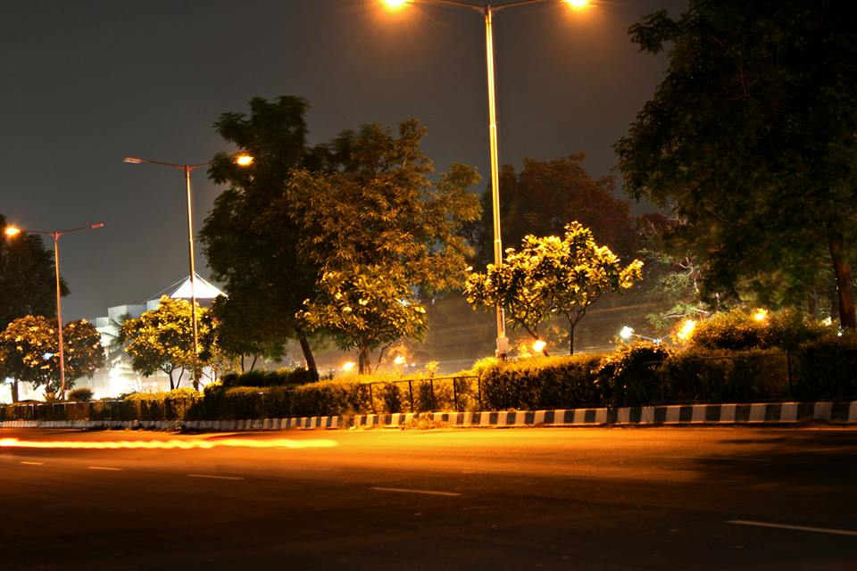
-: Roadways :-
Roads are divided into five categories for administrative purpose Major District Roads, Other District Roads i.e. National Highways, State Highways, and Village Roads.
The Central Govt. is responsible for the maintenance only National Highways.
The State Govt. is responsible for the
maintenance of State Highways,
Major District Roads, Other District Roads
and Village Roads.

Slide 6
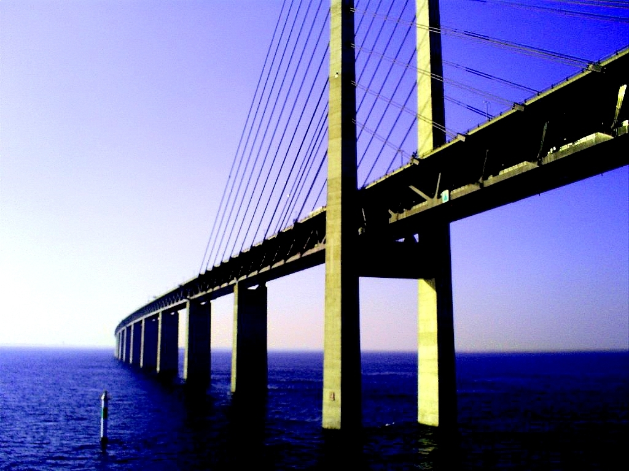
-: Bridge :-
A bridge is a structure built to span physical obstacles such as a body of water, valley, or road, for the purpose of providing passage over the obstacle.
There are many different designs that all serve unique purposes and apply to different situations.
Designs of bridges vary depending on the function of the bridge, the nature of the terrain where the bridge is constructed and anchored, the material used to make it, and the funds available to build it.

Slide 7
-: Types of Bridges :-
Double-decked bridges
Structure Bridge
Movable Bridge
Viaducts Bridge

Slide 8
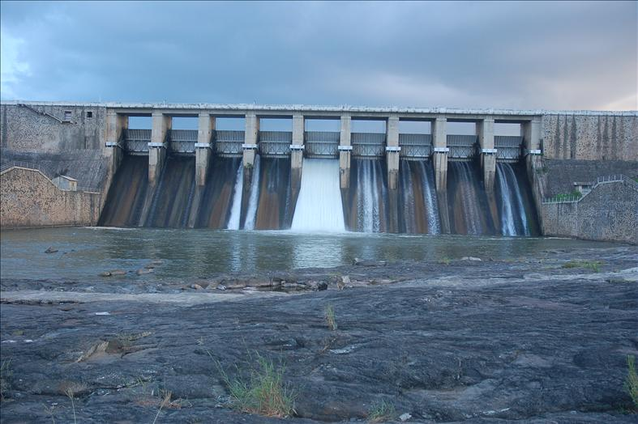
-: Dam :-
A dam is a barrier that impounds water or underground streams.
Dams generally serve the primary purpose of retaining water, while other structures such as floodgates or levees are used to manage or prevent water flow into specific land regions.
Hydropower and pumped-storage hydroelectricity are often used in conjunction with dams to generate electricity.
A dam can also be used to collect water or for storage of water which can be evenly distributed between locations.

Slide 9
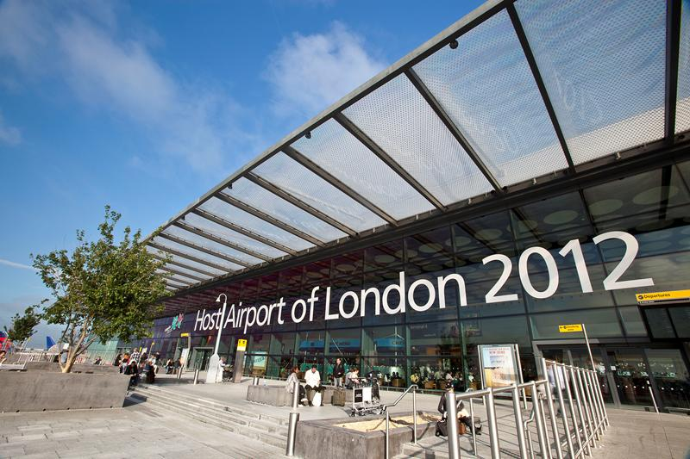
-: Airport :-
An airport is a location where aircraft such as fixed-wing aircraft, helicopters, and blimps take off and land.
Aircraft may be stored or maintained at an airport.
Smaller or less-developed airports - which represent the vast majority - often have a single runway shorter than 1,000 m.
Larger airports for airline flights generally have paved runways
2,000 m or longer.
According to the 1999 Bureau of
Transportation Statistics, there were
5,324 public-use airports and 13,774
private-use airports in the United
States.

Slide 10
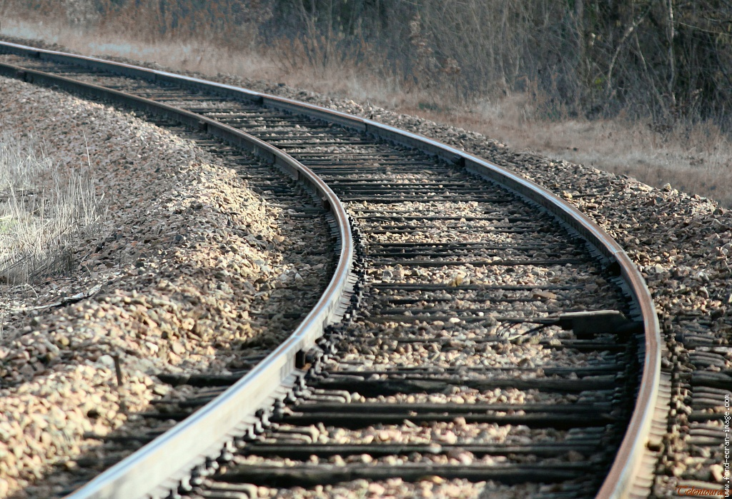
-: Railway :-
Indian Railways is a departmental undertaking of Government of India.
It is overseen by the Ministry of Railways of the Government of India.
Indian Railways has 114,500 kilometres of total track over a route of 65,000 kilometres and 7,500 stations.
It has the world's fourth largest railway network after those of the United States, Russia and China.
The railways traverse the length and breadth of the
country and carry over 30 million passengers and
2.8 million tons of freight daily.

Slide 11
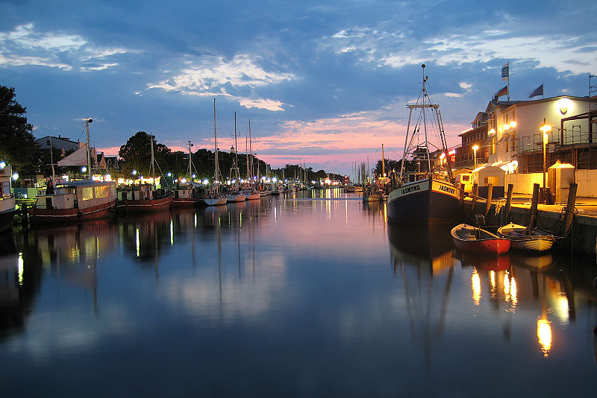
-: Canal :-
Canals are man-made channels for water.
There are two types of canal :-
Waterways : navigable transportation canals used for carrying ships and boats shipping goods and conveying people, further subdivided into two kinds: Those connected to existing lakes, rivers, or oceans. Included are inter-basin canals, such as the Suez Canal, Erie Canal, and the Panama Canal. Those connected in a city network: such as the Canal Grande and others of Venice Italy; the gracht of Amsterdam, and the waterways of Bangkok.
Aqueducts : water supply canals that are used for the conveyance and delivery of potable water for human consumption, municipal uses, and agriculture irrigation. Rills and acquits are small versions.

Slide 12
